Slide 1

B.Tech
BCSE497J– Project-1
Intelligent Investigative Interview Assistant Using Speech Emotion Analysis, Computer Vision and Large Language Models
Team members:
Ajmal Sadhiq (23BCE2201)
Garvit Kohli (23BCE2216)
Aniket Agrawal (23BCE2221)
Faculty guide :
Dr.Sivaprakash S

Slide 2
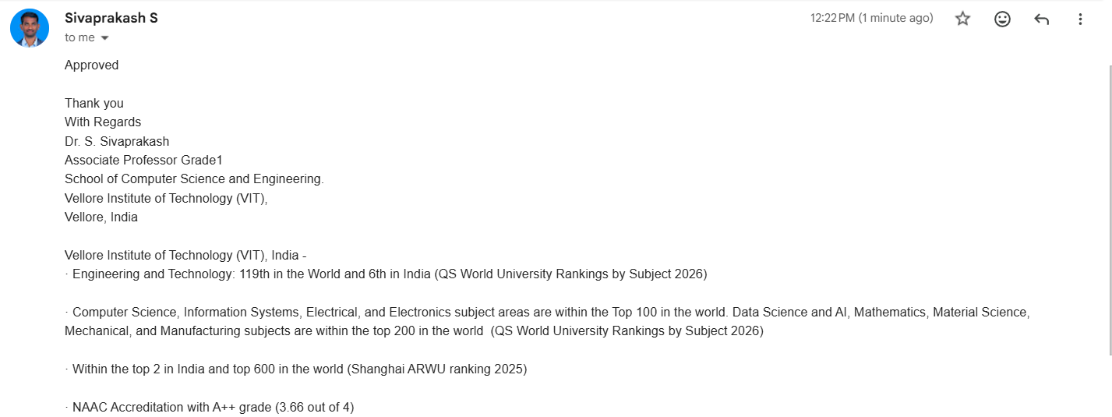
Approval Mail From Guide
Get the approval for the following points from your guide through mail before 01-09-2026.(sample attached below)
Notes:
18858UG02- Project ID

Slide 3
Aim
To develop an AI-assisted investigative interview system that supports law enforcement officers by analysing facial expressions, speech characteristics, and conversational responses in real-time to provide behavioural insights, adaptive questioning, and interview summaries without replacing human decision-making.

Slide 4
Abstract
Traditional investigative interviews depend heavily on an investigator’s experience and observations, which can make behavioural assessments subjective and inconsistent. This project proposes an AI-assisted investigative interview system that combines facial-expression recognition, speech analysis, conversational AI, and adaptive questioning to provide more objective behavioural insights.
The system analyses facial expressions, vocal characteristics, response time, and conversational context to identify behavioural changes without directly determining deception. It can adapt questioning strategies and generate interview summaries, behavioural timelines, and recommendations. The system serves only as a decision-support tool, while final judgements remain with trained law-enforcement personnel.

Slide 5
Literature Review
Paper | Contribution | Limitation
Intu-AI: Digitalization of Police Interrogation Supported by Artificial Intelligence(2025) | AI-assisted police interrogation Facial Emotion Recognition Speech Emotion Recognition Text Emotion Analysis Automated documentation | Limited adaptive questioning No behavioural timeline
Detecting Lies in Investigative Interview Through Response Latencies and Unexpected Questions (Nature,2024) | Response latency analysis Cognitive load estimation Unexpected questioning | No multimodal emotion recognition No AI conversational assistant
LAPIS: Language Model-Augmented Police Investigation System (2024) | LLM-powered police assistant Legal reasoning Investigation guidance | No real-time behavioural analysis No facial or speech processing

Slide 6
Literature Review
Paper | Contribution | Limitation
A Deception Detection Model Using Integrated LLM with Emotion Features (2025) | Multimodal emotion fusion Behavioural feature extraction LLM integration | Focuses on classification Doesn’t support adaptive interviewing
AI-Driven Policing Using Police Body-Worn Cameras (2025) | Behaviour recognition Video understanding Audio analysis Event summarization | Focuses on bodycam footage Not designed for suspect interviews

Slide 7
Research Gap
Current AI systems primarily focus on isolated tasks such as facial emotion recognition, speech analysis, deception classification, or legal reasoning. Existing solutions rarely integrate these capabilities into a unified investigative interview platform.
Current limitations include:
Static interview process
No adaptive questioning strategy
Limited integration of facial, speech, and textual cues
Lack of real-time investigator assistance
No behavioural timeline visualization
Minimal explainability of AI recommendations
Heavy dependence on offline analysis rather than live decision support

Slide 8


Objectives
Sustainable Development Goals
SDG 9 : Industry, Innovation and Infrastructure
SDG 16: Peace, Justice and Strong Institutions
Identified: Sustainable Development Goals | | Outcome: Conference(Scopus)

Slide 9
Framework/Architecture/Block Diagram
Input: webcam, microphone, interview questions and responses, response timestamps, and interview language selection
Processing: face detection, facial-expression recognition, speech-to-text conversion, language identification, and speech-emotion and vocal-feature analysis
Multimodal fusion: combines facial, vocal, textual and latency features, establishes an initial behavioural baseline, compares current signals with the baseline, and records the signals contributing to each observation.
LLM : receives the interview objective and conversation history, reviews transcript and behavioural observations, and generates neutral, non-leading questions and provides reasoning for each question.

Slide 10
Dashboard: real-time transcript, current and suggested questions, facial and speech observations, and separate observed, interpreted, and recommended sections
Report : stores interview details, transcripts, generated questions, behavioural observations, and investigator notes and recommendations.
Input
Processing
Multimodal Fusion
LLM
Dashboard
Report

Slide 11
Functional Requirements
Capture live video and audio during an interview
Detect facial expressions through a webcam input
Recognize speech emotion and vocal characteristics
Support multi-lingual interviews across major Indian languages
Convert speech from different Indian languages into text
Measure response time and identify any behavioural changes
Generating adaptive follow-up questions in the language selected for the interview
Display live behavioural insights on an investigator dashboard
Generating interview summaries an behavioural timelines
Store interview records securely for authorized access
Produce transcripts and interview summaries in the original language along with optional English translation
Keep final decisions under the investigator’s control

Slide 12
Modules
User and session management: Investigator login, and interview creation and session control
Video processing module: Webcam capture, face detection, and facial-expression recognition
Audio and speech module: Audio capture, speech-to-text conversion, speech-emotion and vocal-stress analysis
Conversational AI module: Analyse the interview context, generate adaptive follow-up questions, and maintain conversation history
Behavioural analysis module: Combine facial, vocal, response-time, and textual cues, identify changes and inconsistencies, and avoid directly classifying a person as truthful or deceptive

Slide 13
Modules
Dashboard and reporting module: Display real-time behavioural indicators, and generate transcripts, timelines, summaries, and recommendations
Database module: Store interview details, transcripts, detected emotions, and reports

Slide 14
Experiments and Results
Setup: Webcam, microphone, sample interview questions, backend, database, and dashboard
Test cases:
Normal or neutral response
Emotional or stressed response
Delayed response
Change in facial expression
Adaptive follow-up question generation

Slide 15
Experiments and Results
Evaluation measures:
Facial-emotion accuracy
Speech-emotion accuracy
Speech-to-text accuracy or word error rate
Average processing time
Successful adaptive-question generation
Current limitations: lighting, background noises, accent variations, limited training data, and occasional errors by the LLM.

Slide 16
Conclusion
An initial AI-assisted investigative interview prototype has been developed
The system integrates facial expression, speech processing, and LLM-base adaptive questioning
Provides live behavioural observations, interview transcripts, summaries, and timelines
The prototype demonstrates how multimodal AI can improve consistency and support investigators during interviews.
The system doesn’t determine deception or replace investigators, with the final decision remaining with the law-enforcement personnel
Expand and evaluate the system using diverse Indian-language, accent, and dialect datasets to reduce linguistic bias and improve accuracy

Slide 17
References
[1] INTU-AI: Digitalization of Police Interrogation Supported by Artificial Intelligence. Applied Sciences, 2025.
[2] Detecting Lies in Investigative Interviews Through Response Latencies and Unexpected Questions. Scientific Reports (Nature), 2024.
[3] LAPIS: Language Model-Augmented Police Investigation System. arXiv, 2024.
[4] A Deception Detection Model Using Integrated LLM with Emotion Features. Scientific Reports, 2025.
[5] Introducing Representations of Facial Affect in Automated Multimodal Deception Detection. arXiv, 2020
[6] Towards AI-Driven Policing: Knowledge Discovery from Police Body-Worn Camera Footage. arXiv, 2025.
[7] Z. Wu, B. Singh, L. S. Davis, and V. S. Subrahmanian, "Deception Detection in Videos," in Proc. AAAI Conf. Artificial Intelligence (AAAI), New Orleans, LA, USA, 2018, pp. 1695–1702.

Slide 18
References
[8] M. M. M. Miah, A. Anika, X. Shi, and R. Huang, "Hidden in Plain Sight: Evaluation of the Deception Detection Capabilities of LLMs in Multimodal Settings," in Proc. 63rd Annual Meeting of the Association for Computational Linguistics (ACL), Vienna, Austria, 2025, pp. 31013–31034.
[9] R. I. A. Baldivas, N. Sreenivasan, S. Y. Kang, A. M.-L. Miller, M. Chacko, S. Krishnan, C. Ayala, E. Ayala, and D. Kim, "LegalEye: Multimodal Court Deception Detection Across Multiple Languages," Behavioral Sciences, vol. 15, no. 12, Art. no. 1707, Dec. 2025.
[10] V. Sharma and S. O'Brien, "DecepBench: Benchmarking Multimodal Deception Detection," in Proc. 3rd Workshop on Social Influence in Conversations (SICon), Association for Computational Linguistics, Vienna, Austria, 2025, pp. 50–64.
[11] S. Poria, D. Hazarika, N. Majumder, G. Naik, E. Cambria, and R. Mihalcea, "MELD: A Multimodal Multi-Party Dataset for Emotion Recognition in Conversations," in Proc. 57th Annual Meeting of the Association for Computational Linguistics (ACL), Florence, Italy, 2019, pp. 527–536.
[12] W. Yu, H. Xu, Z. Yuan, and J. Wu, "Learning Modality-Specific Representations with Self-Supervised Multi-Task Learning for Multimodal Sentiment Analysis," in Proc. AAAI Conf. Artificial Intelligence (AAAI), Virtual Conference, 2021, pp. 10790–10797.

